Slide 1
Tópicos Especiais em Telecomunicações IV: Tecnologias de Acesso e Soluções Emergentes para Redes 5G e Além
Aula 9: Combinadores e Pré-codificadores em sistemas massive MIMO
Prof. Dr. João Crisóstomo Weyl Albuquerque Costa (jweyl@ufpa.br)
André Lucas Pinho Fernandes (andrelpf@ufpa.br)
Daynara Dias Souza (daynara@ufpa.br)

Slide 2
Outline
Uplink System Model
Receive Combining
Computational Complexity
Comparison of Combining Schemes
Downlink System model
Transmit Precoding
Computational Complexity
Comparison of Precoding Schemes
Pilot contamination
Summary of massive MIMO systems

Slide 3
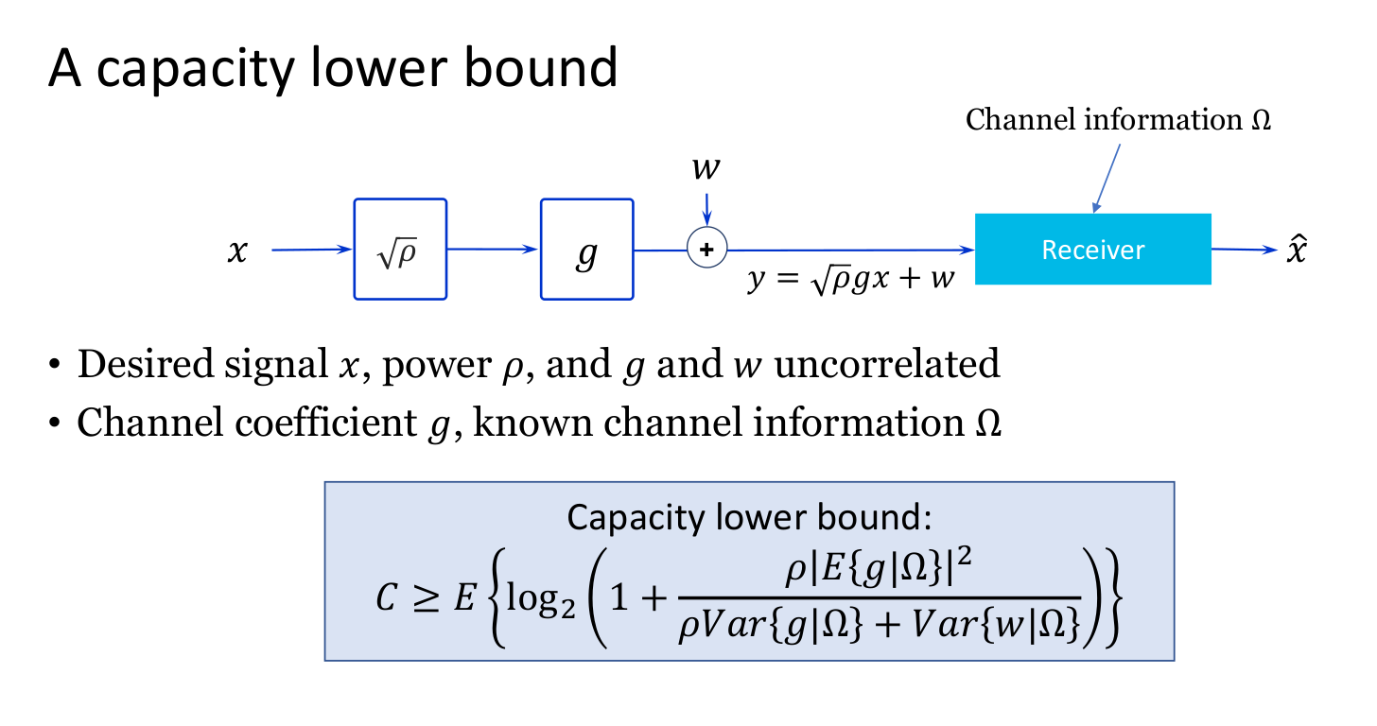

Slide 4
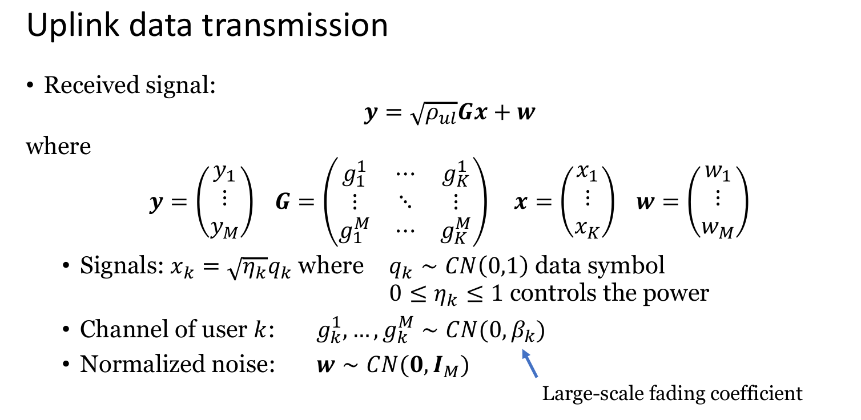

Slide 5
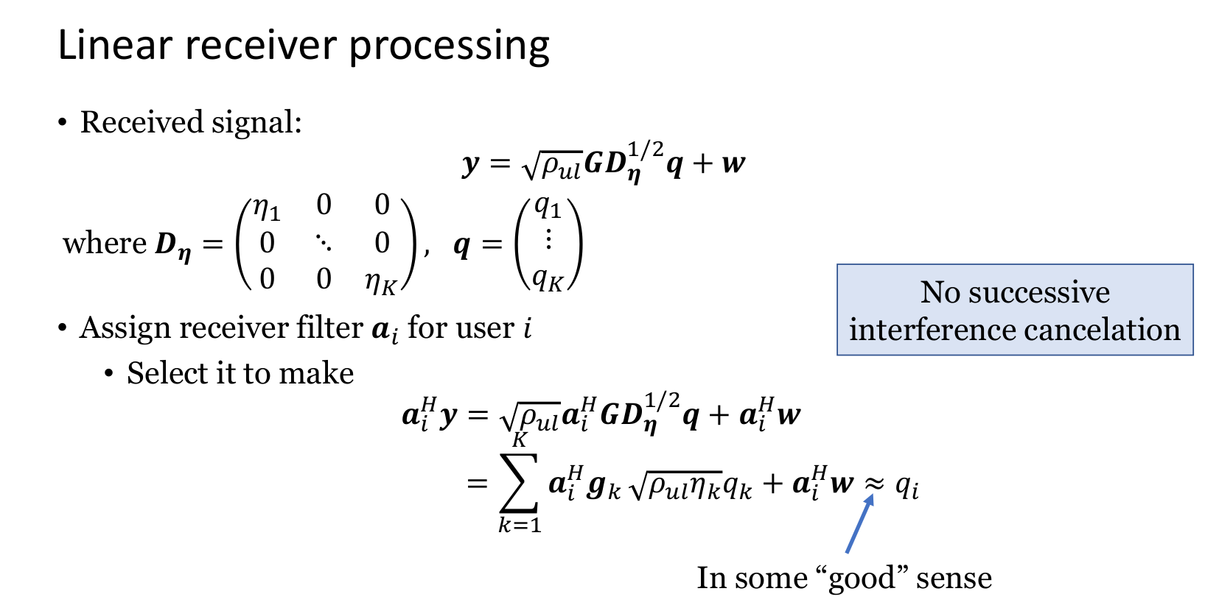

Slide 6
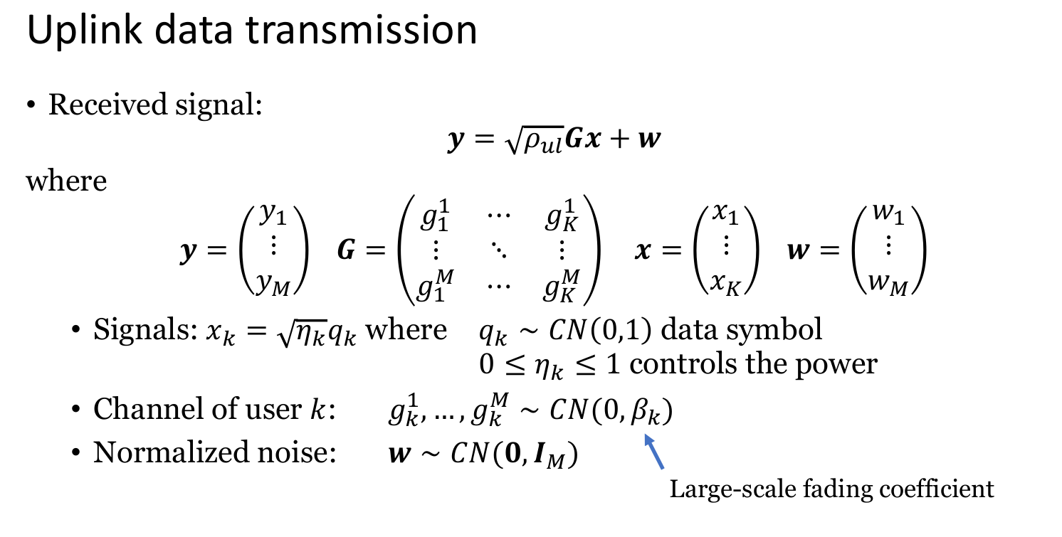

Slide 7
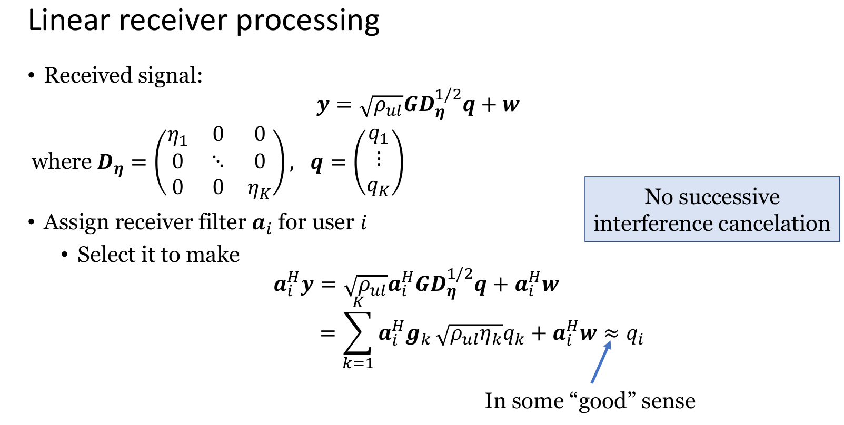

Slide 8
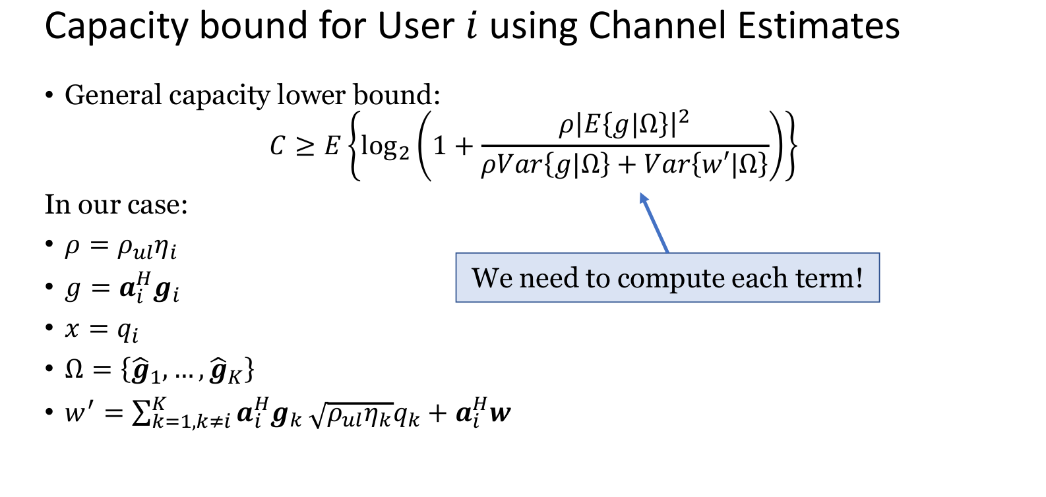

Slide 9
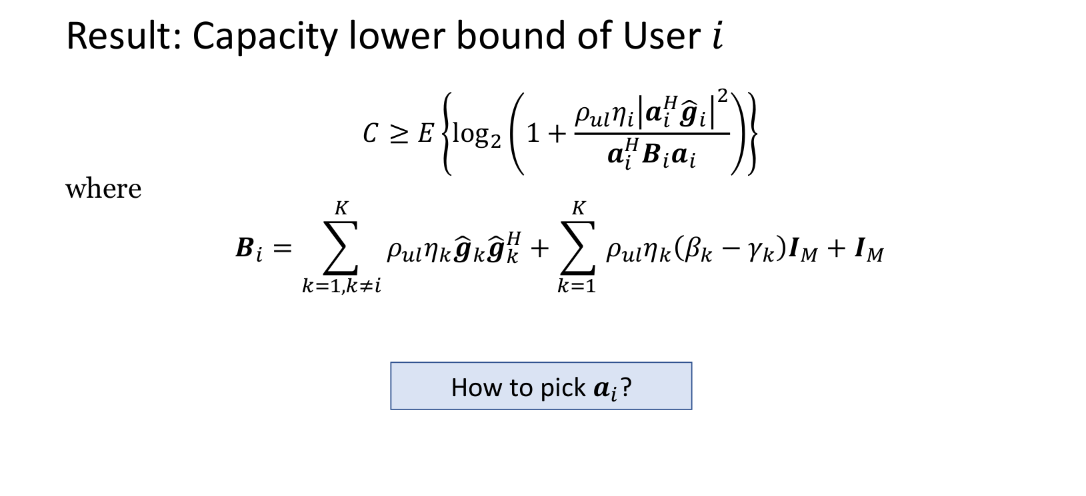

Slide 10
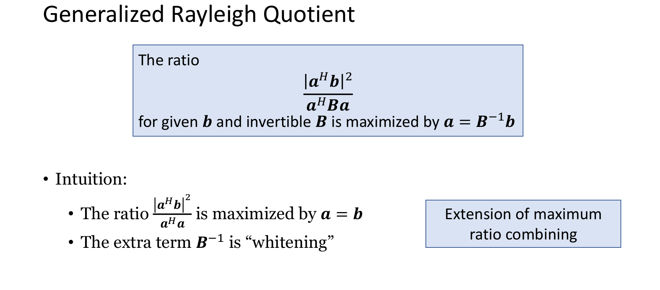

Slide 11
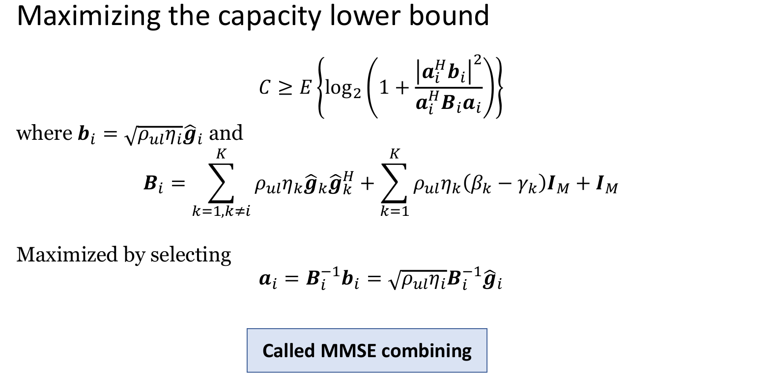

Slide 12
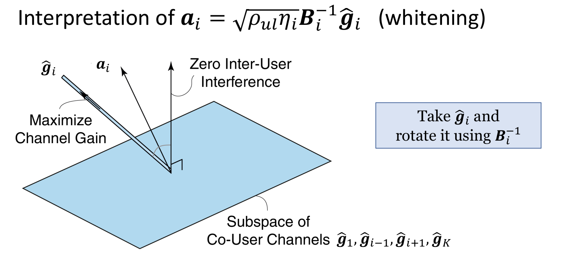

Slide 13
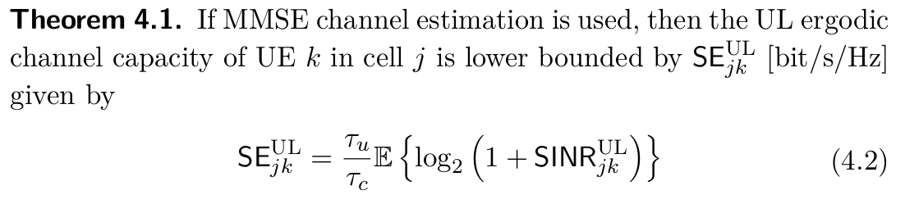
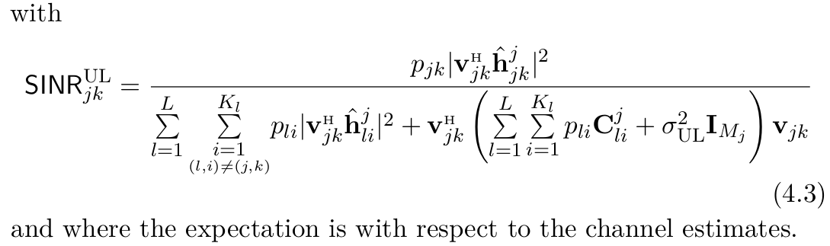
Uplink Spectral Efficiency for Multicell Systems

Slide 14
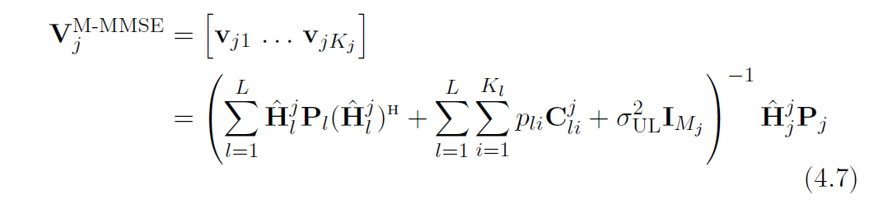
Optimal M-MMSE Receive Combining
correlation matrix of estimation error
diagonal matrix with the transmit powers
M-MMSE combining finds a non-trivial tradeoff between high signal power and low interference/noise, which maximizes the instantaneous SINR.
High computational complexity.
The complexity is also affected by the need to estimate the channels and acquiring the channel statistics of all UEs.
The performance of M-MMSE is hard to analyze mathematically

Slide 15
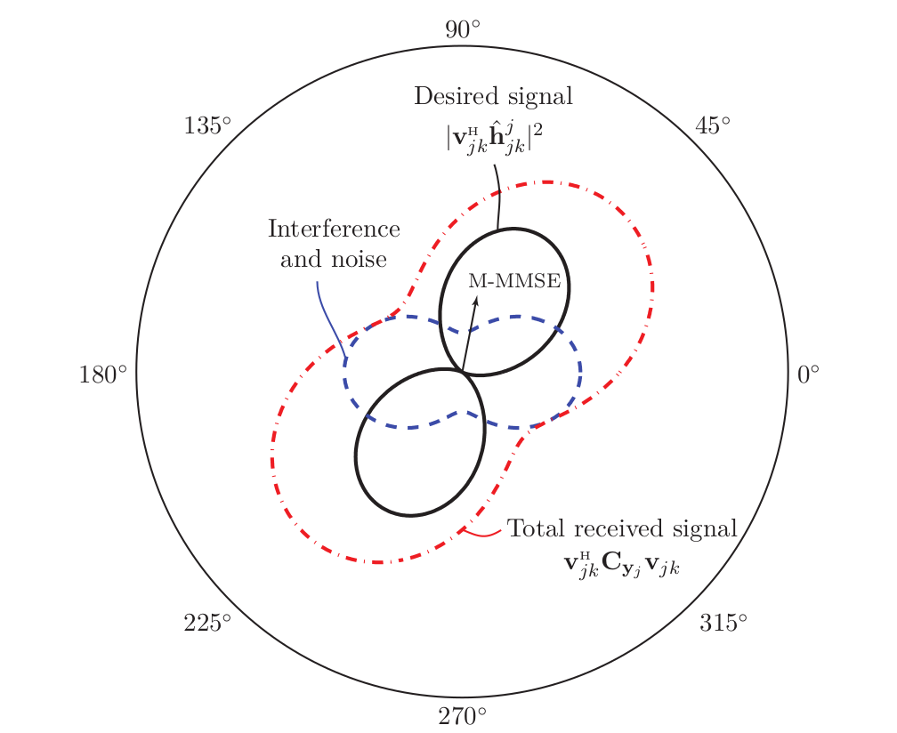
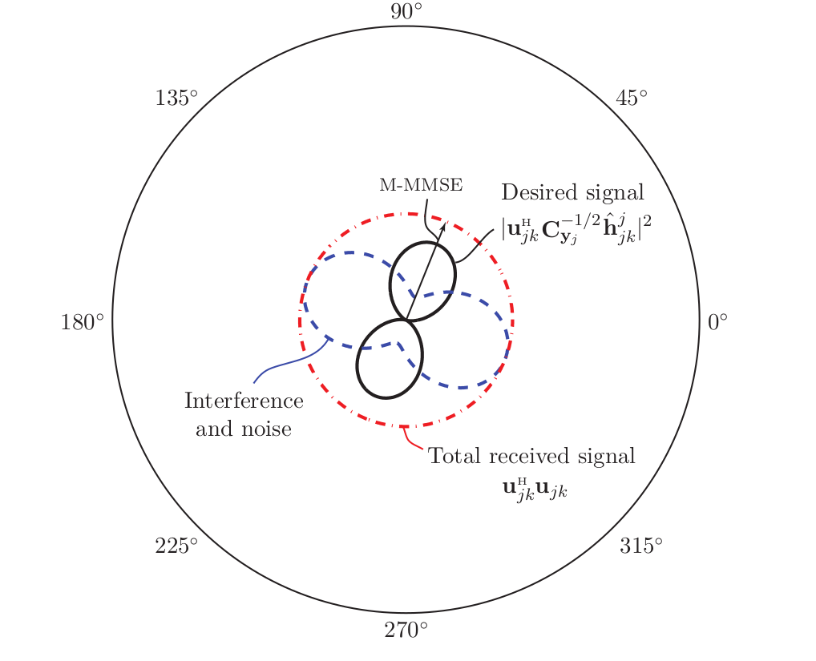
Optimal M-MMSE Receive Combining

Slide 16
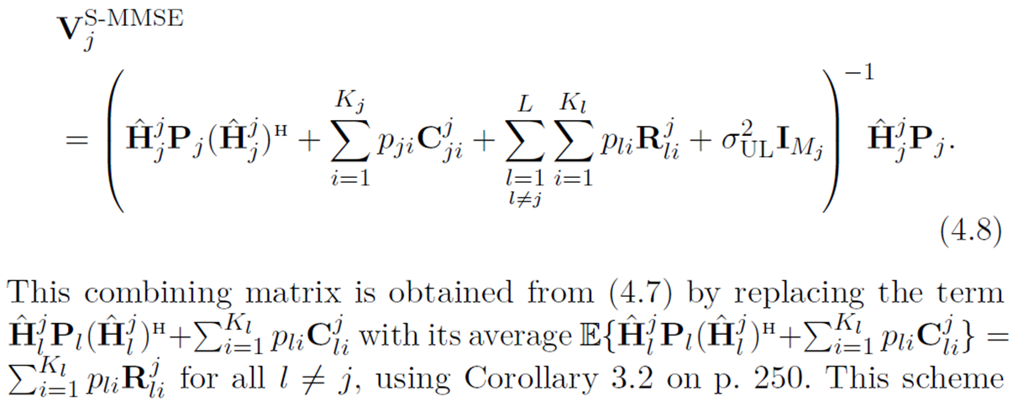
Alternative S-MMSE Receive Combining
If BS j only estimates the channels from its own UEs, we obtain the single-cell minimum mean-squared error (S-MMSE)
spatial correlation matrix
This scheme coincides with M-MMSE when there is only one isolated cell, but is generally different and has a substantially weaker ability to suppress interference from interfering UEs in other cells.
This can be a major drawback since a few strong interfering UEs in other cells might be located near the cell edge and thus cause as much interference as the intra-cell UEs.

Slide 17
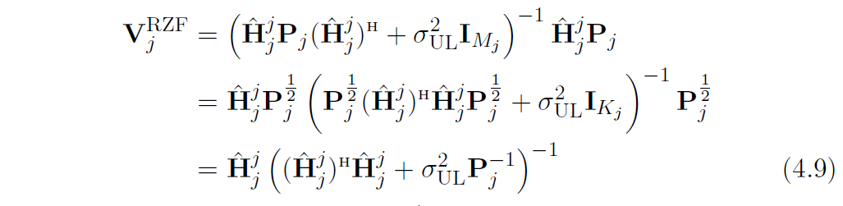
Alternative RZF Receive Combining
If the channel conditions are good and the interfering signals from other cells are weak, we can neglect all the correlation matrices in (4.8)
We call this regularized zero-forcing (RZF) combining.
pseudo-inverse
regularization
The main benefit over S-MMSE is that a Kj × Kj matrix is inverted in (4.9) instead of an Mj ×Mj matrix, which can substantially reduce the complexity since Mj >> Kj is typical in Massive MIMO.
The regularization terminology refers to the fact that (4.9) is a pseudo-inverse has been regularized by the diagonal matrix. Regularization, provides weighting between interference suppression (for small regularization terms) and maximizing the desired signals (for large regularization terms).

Slide 18
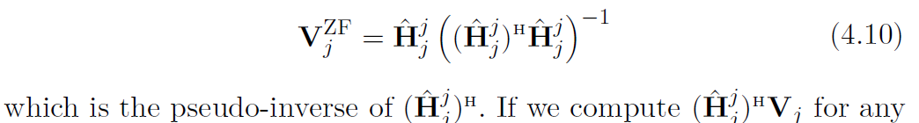
Alternative ZF Receive Combining
The combining expression in (4.9) can be further approximated when the SNR is high or there is many antennas.
In both cases, we can neglect the regularization term and obtain the zero-forcing (ZF) combining matrix:
Called ZF because (on average) all the interference from intra-cell UEs is canceled, while the desired signals remain non-zero.
Since not every UE exhibits a high SNR in practice, it is expected that ZF will provide lower SEs than RZF.

Slide 19
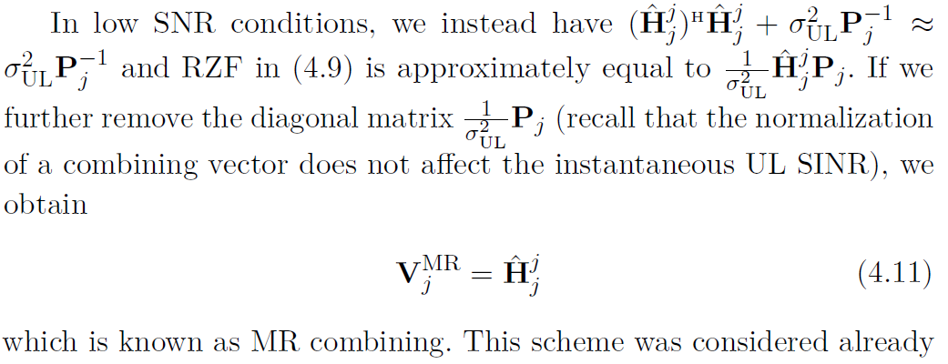
Alternative MR Receive Combining
Note that MR does not require any matrix inversion, in contrast to the previously mentioned schemes. Since not every UE exhibits a low SNR in practice, it is expected that MR will provide lower SEs than RZF.

Slide 20
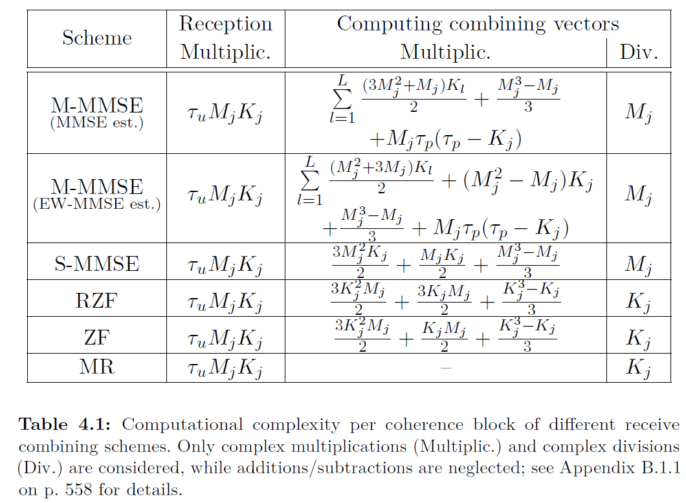
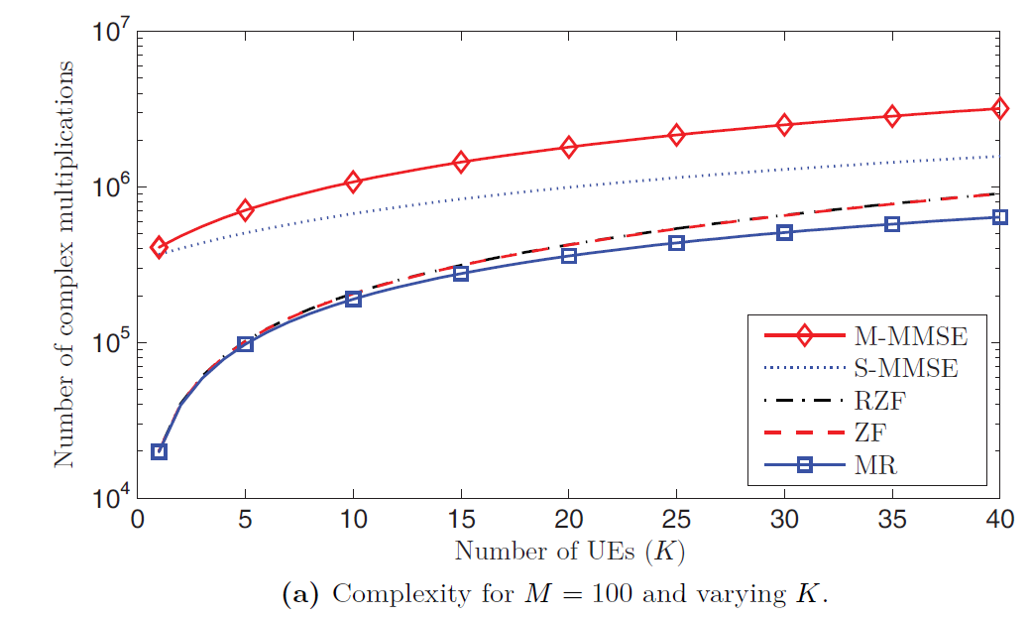
Computational Complexity of Receive Combining

Slide 21
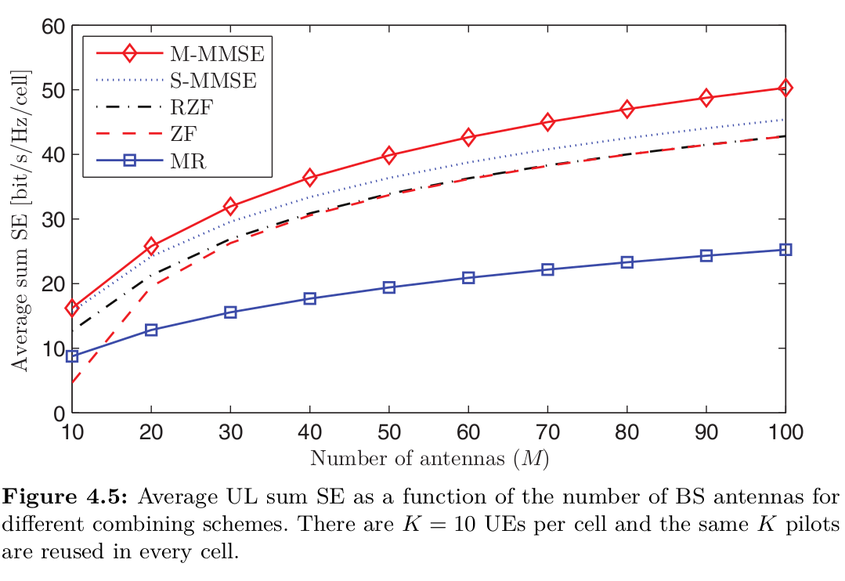
Uplink Spectral Efficiency

Slide 22
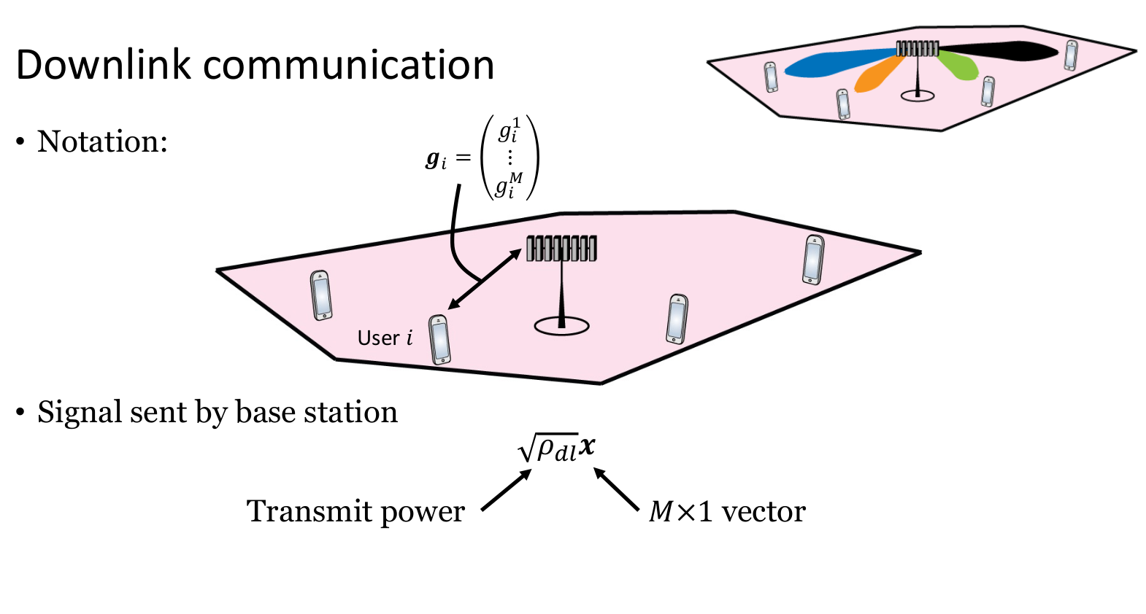

Slide 23
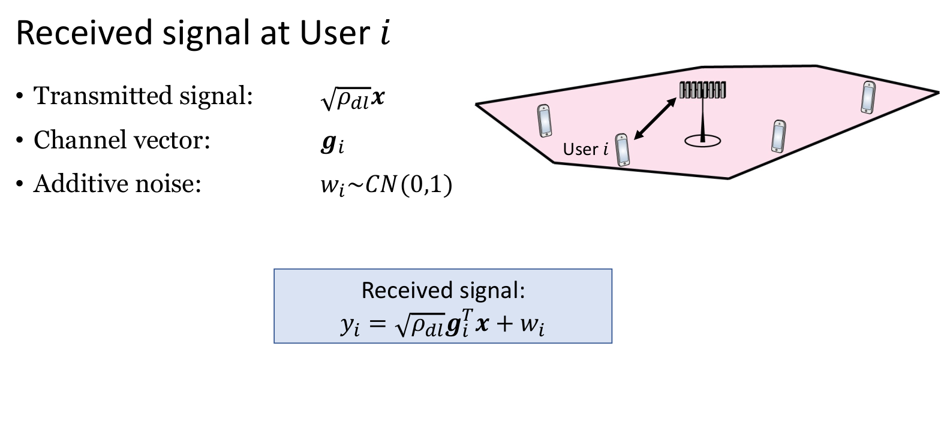

Slide 24
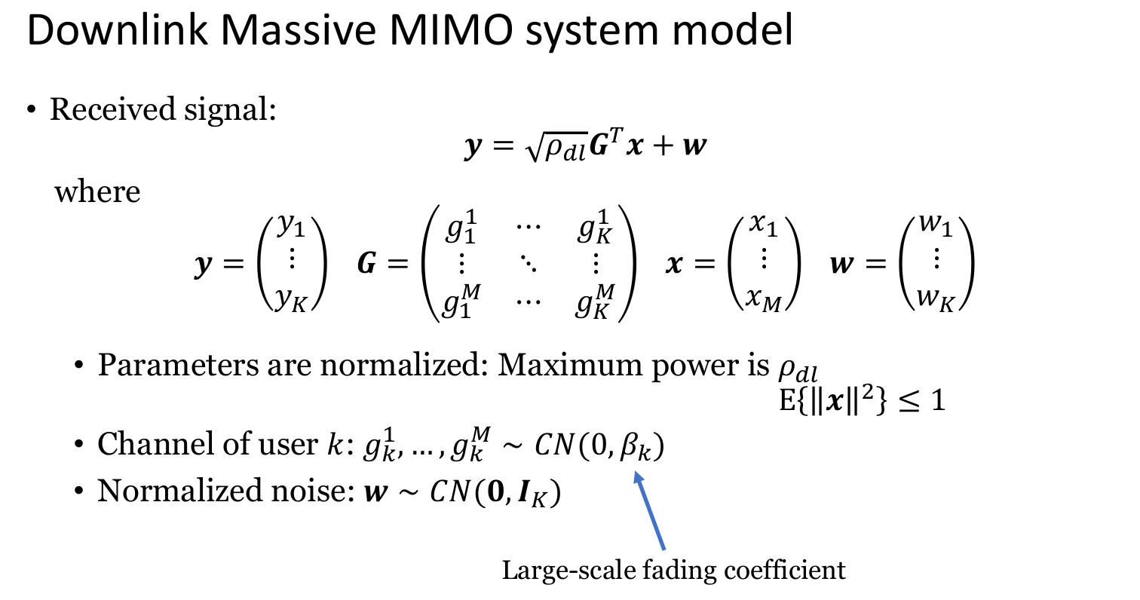

Slide 25
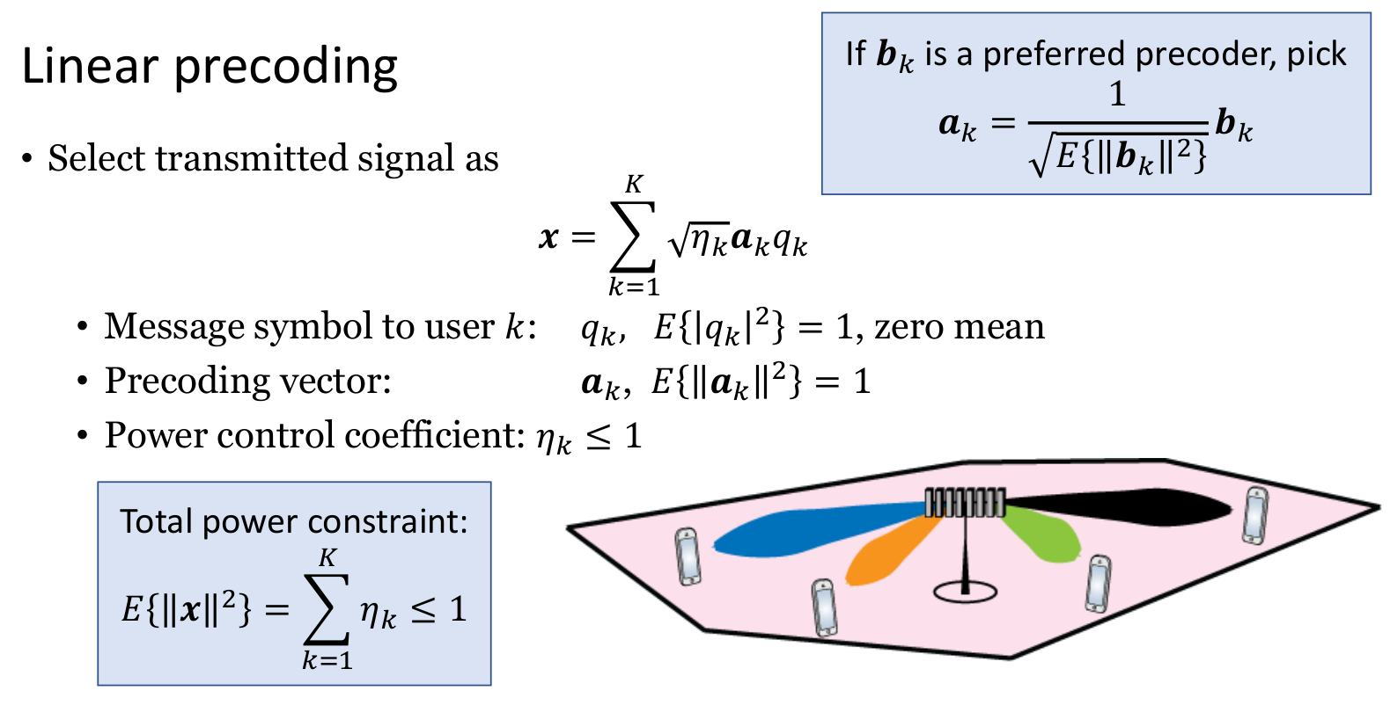

Slide 26
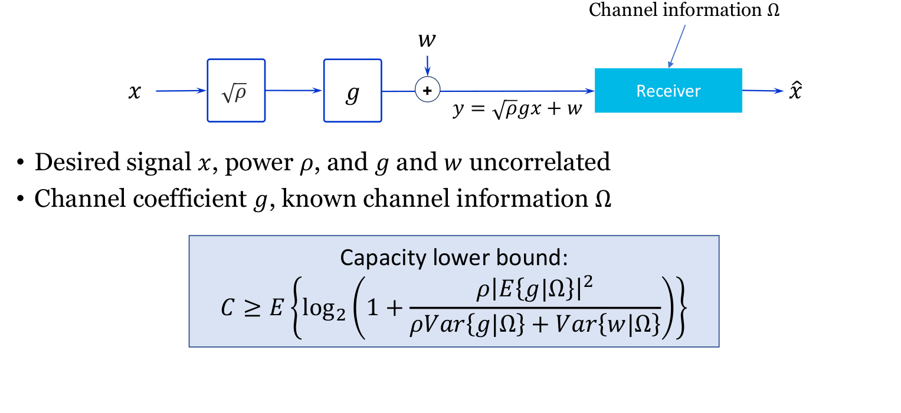
Capacity lower bound

Slide 27
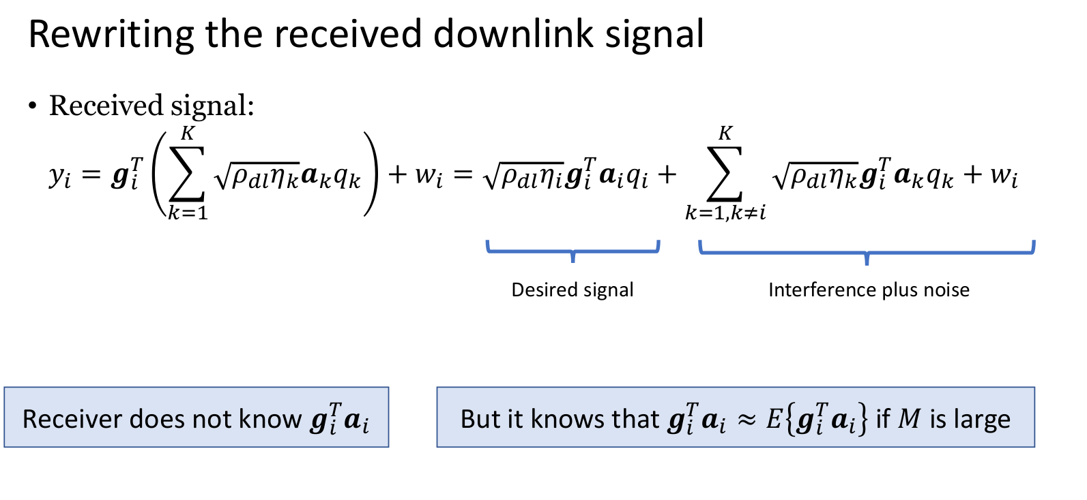

Slide 28
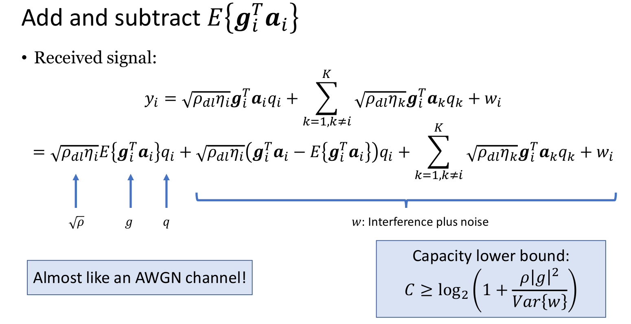

Slide 29
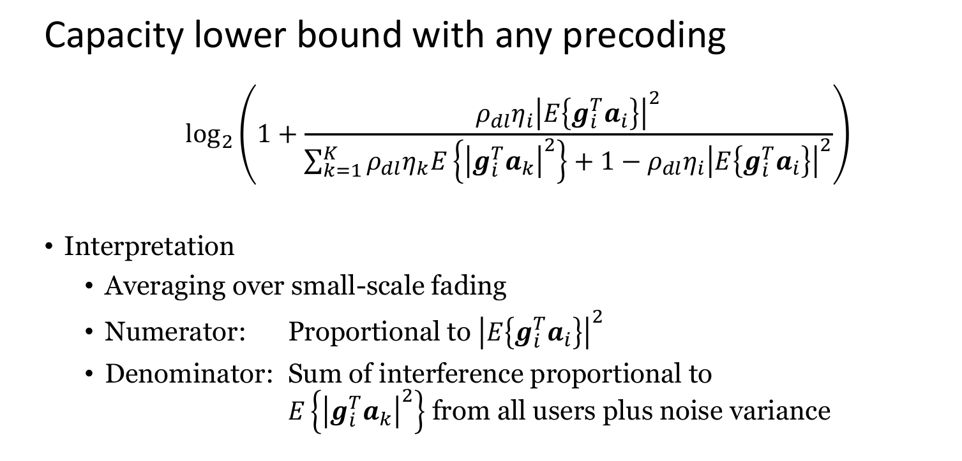

Slide 30
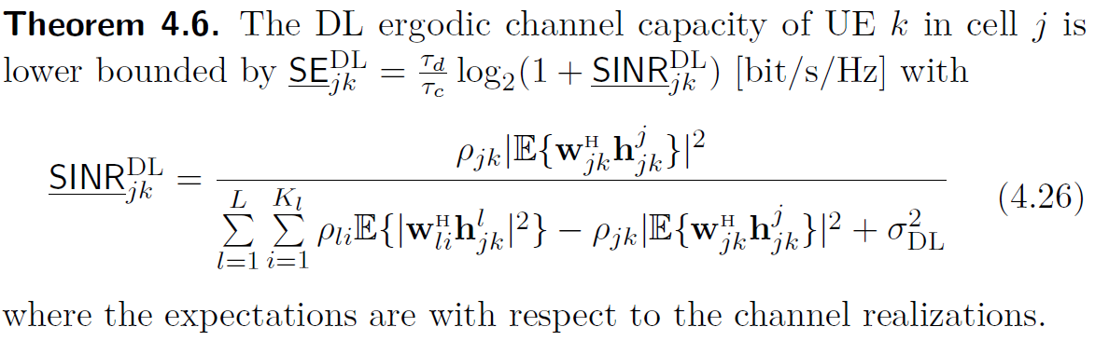
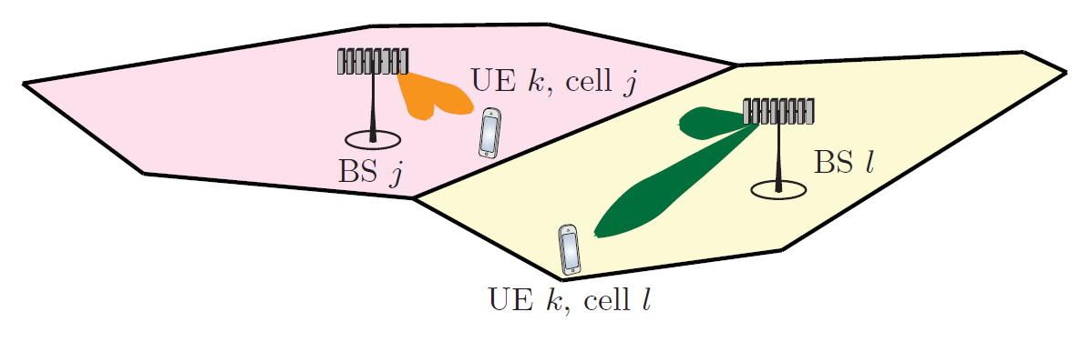
Downlink Spectral Efficiency for Multicell Systems
General expression – hardening bound

Slide 31
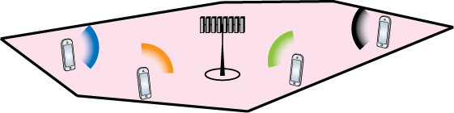
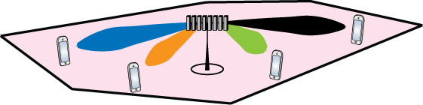
How to select precoding?
Precoding principle
Transmit in the direction where you heard the users “most clearly”

Slide 32
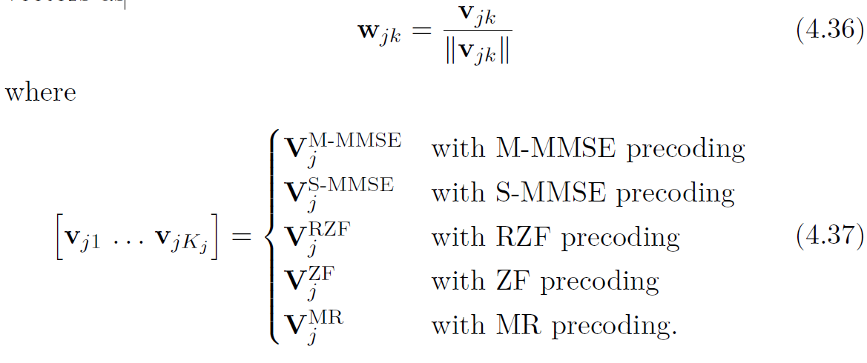
Principle for Precoding Design
Select the DL precoding vectors based on the UL receive combining vectors as
Motivated by the UL-DL duality
One important benefit of using the receive combining vectors for transmit precoding is that the computational complexity of computing the precoding vectors reduces.

Slide 33
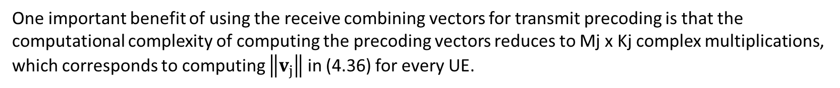
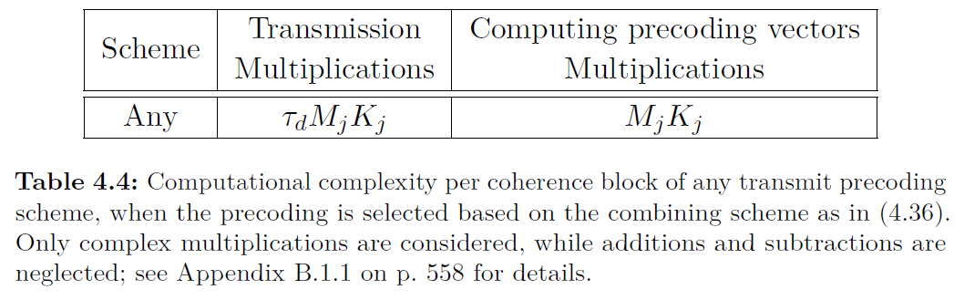
Computational Complexity of Transmit Precoding

Slide 34
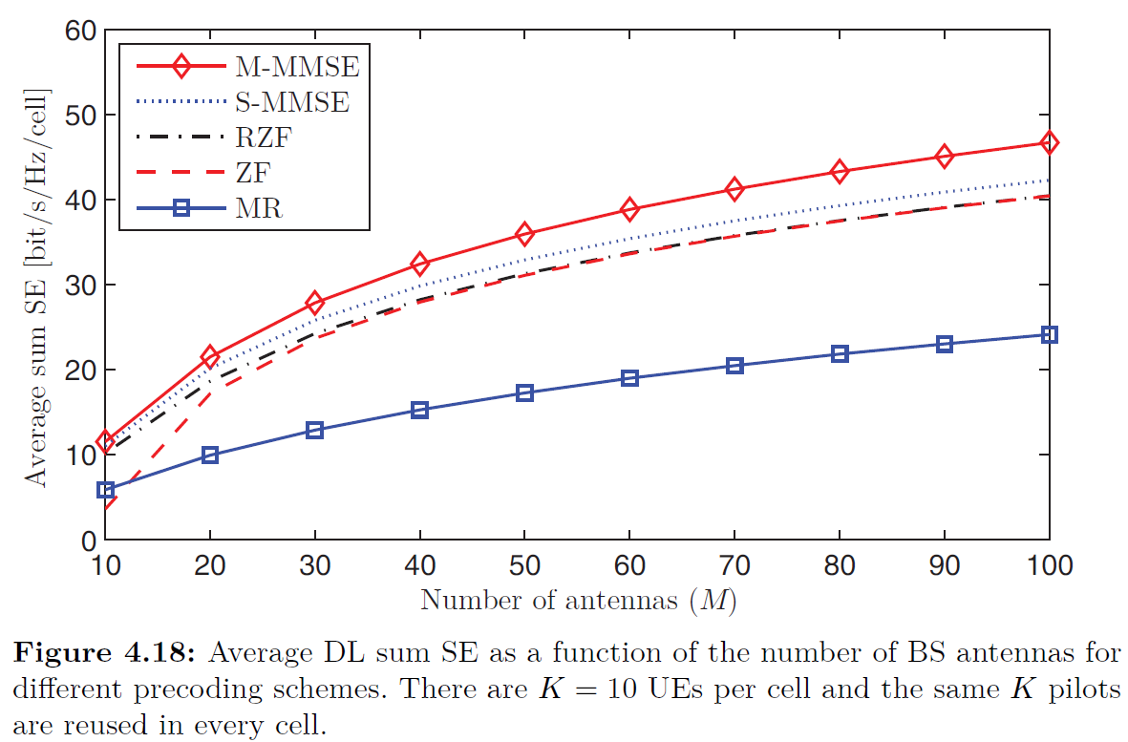
Comparison of Precoding Schemes
M-MMSE provides the highest SE for any number of antennas.
S-MMSE, RZF, and ZF provide almost the same SE, except that ZF has robustness issues for M < 20 antennas.
Finally, MR provides the lowest SE among all schemes.
MR achieves only 40%–50% of the SE provided by M-MMSE and 50%–60% of the SE provided by RZF.
The computational complexity is higher for the precoding/combining schemes that provide higher SEs, and we can appoint M-MMSE, RZF, and MR as three distinct tradeoffs between high SE and low complexity. These are the schemes to choose between in a practical implementation.

Slide 35
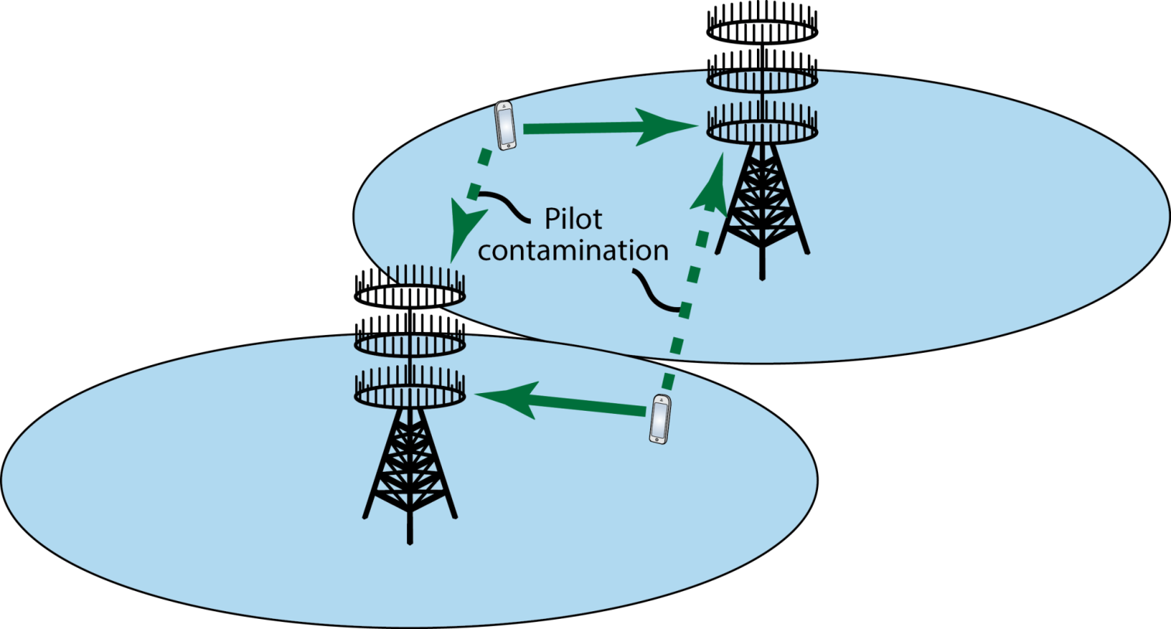
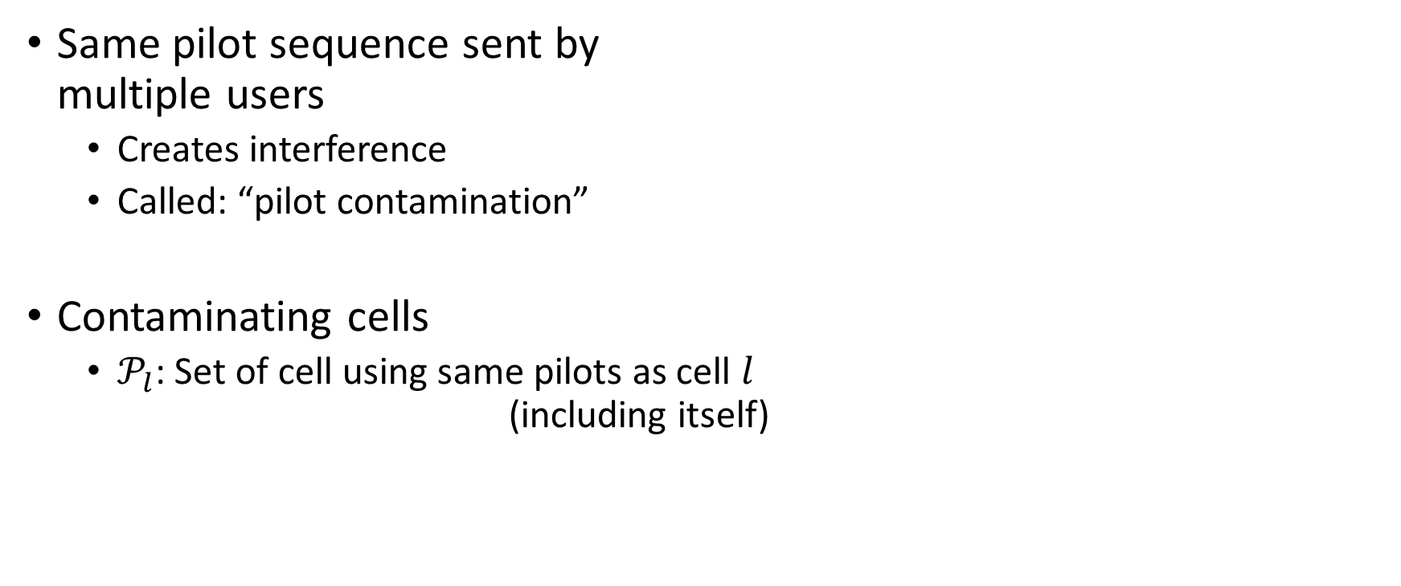
Impact of pilot reuse

Slide 36
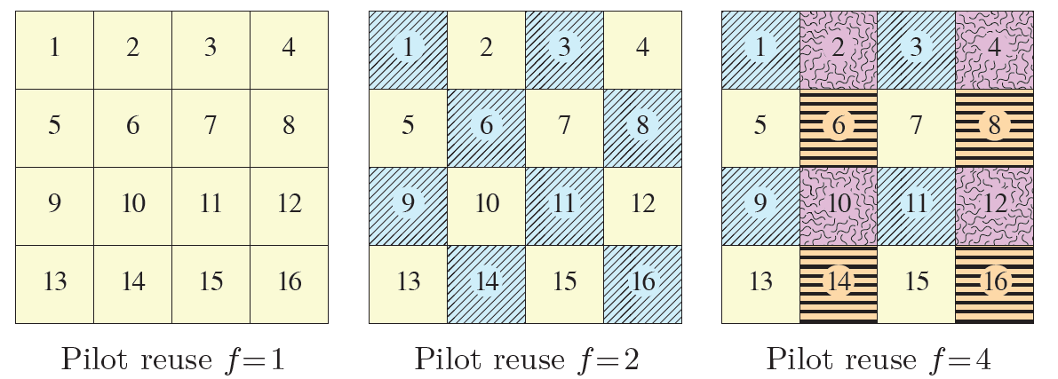
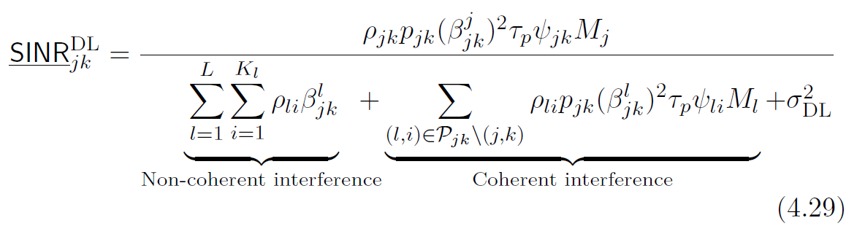
Pilot contamination
The BS uses precoding to direct the signals towards the intended receivers, but partially also direct them towards the UEs that interfered with the pilot transmission.
MR

Slide 37
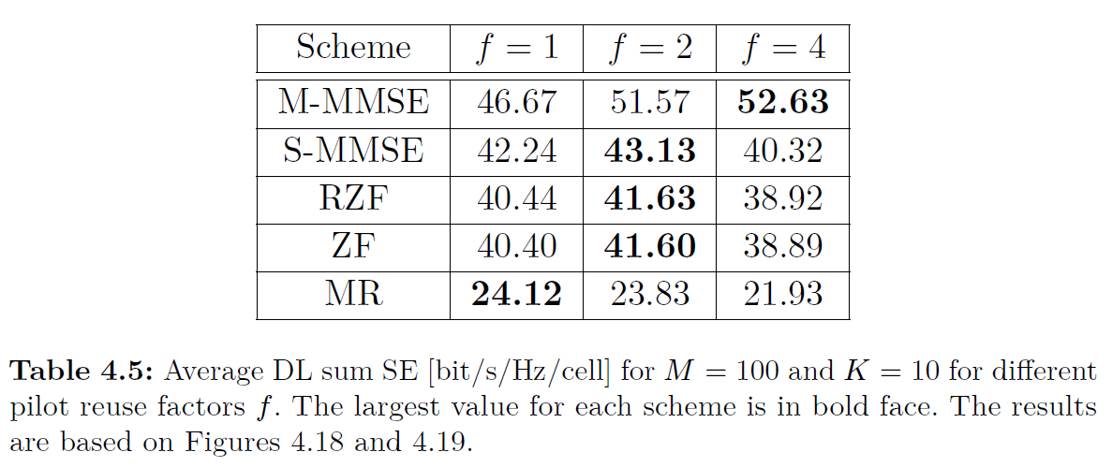
Pilot contamination and Comparison of Precoding Schemes
M-MMSE gives its highest performance with f = 4, S-MMSE, RZF, and ZF prefer f = 2, and MR gives its highest SE with f = 1.

Slide 38
Comparing uplink and downlink
Uplink: Interference comes from each user
Downlink: Interference comes from each base station

Slide 39
Summary
• Mobile communications require multiple antennas
• Adaptive directive transmission (beamforming gain)
• Mitigate channel fading (diversity gain)
• Increase data rates (multiplexing gain)
• Useful in low-band, mid-band, and high-band spectrum

Slide 40
Summary
• Same capacity of SIMO and MISO channels
• Achieved by beamforming: maximum ratio combining/transmission
• Line-of-sight channels
• All antennas contribute equally
• Phase-shifts depend on angles
• Beamforming gain of 𝑀
• Beamwidth shrinks as 1/𝑀

Slide 41
Summary
• Capacity of 𝑀 × 𝐾 MIMO channel
• Send 𝐾 different messages along eigenvectors of 𝑮^{H}𝑮
• This creates 𝐾 parallel channels
• Divide power using waterfilling
• High SNR: Multiplexing gain
• Low SNR: Beamforming gain

Slide 42
Summary
• Point-to-point MIMO channels
• Large multiplexing gains are hard to achieve in practice
• Multi-user MIMO channels
• Similar system model
• Key differences: Independent users, different power, different performance

Slide 43
Summary
• Massive MIMO is multi-user MIMO with many antennas and users
• No strict definition exists
• TDD operation
• Divide time-frequency resources into frames
• Match frame size to coherence intervals
• Send uplink pilots for channel estimation
• Switch between uplink/downlink data in same coherence interval

Slide 44
Summary
• Channel estimation
• Send pilot sequences of length 𝜏_{p} ≥ 𝐾 in the uplink
• Preferable to estimate channels using MMSE estimation
• Alternative EW-MMSE or LS estimation for lower complexity and unknown channel statistics
• Pilot contamination
• Reduces estimation quality
• Correlates channel estimates
• Causes coherent interference

Slide 45
Summary
• MMSE processing
• Highest performance, complicated capacity expression
• ZF processing
• Closed-form expression for uncorrelated Rayleigh fading, requires 𝑀 > 𝐾
• Lower complexity than MMSE processing, but inferior performance
• MR processing
• Closed-form expression, greatly inferior performance
• Lowest computational complexity

